Slide 1

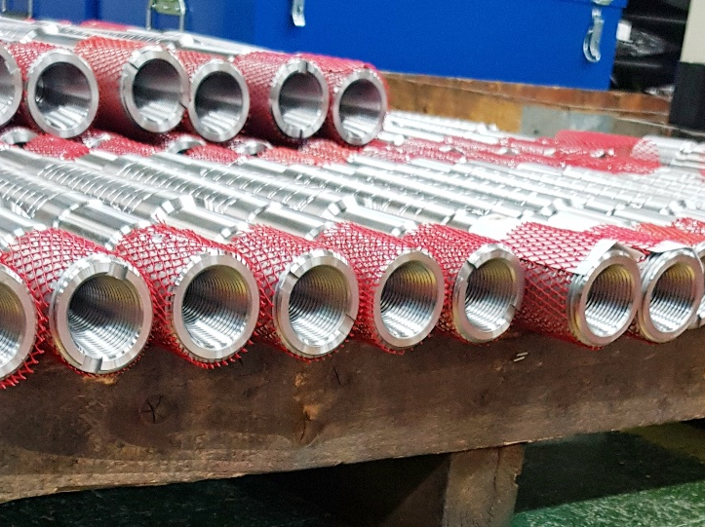
Small size Radial Fit Bolts for coupling in a Combined Cycle Power Plant
SIEMENS POWER GENERATION were awarded the contract to supply a SST-3000 Steam turbine, a SGT5-4000F Gas Turbine and a SGen5-2200H Generator for the newly built 450 MW Be’er Tuvia power plant, which is planned to supply 3.5% of Israel’s electricity needs up to 2040 via the most efficient plant in the country. Approximate cost of building the plant is US $2.0 billion, expected to be operating by the end of 2020.
In parallel PILGRIM were already in discussions with SIEMENS to design and provide a standard coupling bolt solution based upon PILGRIM’s Radial Fit Bolt technology. The Be’er Tuvia coupling bolts were the same size as the standardisation project, however the project had not yet been concluded, however it was a great opportunity to test some of the design concepts in a live project.
Siemens Power Generation
Hydraulically installed Radial Fit Bolts for the Low Pressure steam turbines. At 43mm diameter, these are also amongst the smallest RFBs we have supplied to SIEMENS in over 30 years of working together.
16 off RFB 43mm Ø x 180mm Length + Windage Plugs
1 off Bolt tensioning kit
1 off Morpress air driven hydraulic pump.
Reduction of vibration in system due to “truly fitted bolts”.
Easy to install & remove.
A live trial of design principles of the coupling bolt standardisation project.

